Slide 1
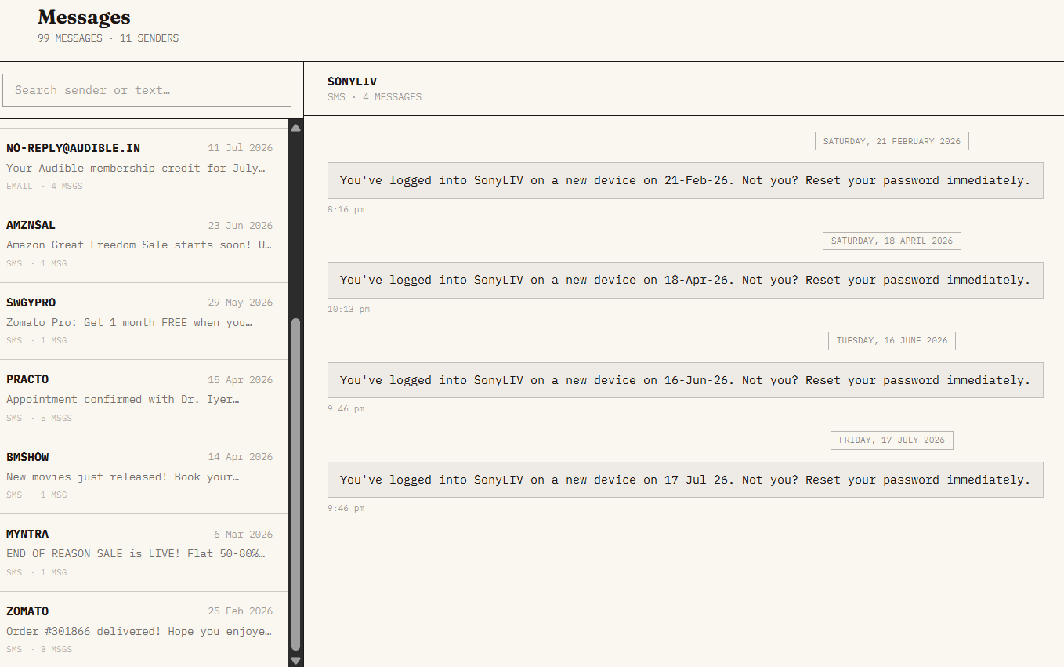
LEAKLENS
FINTECH · PROBLEM STATEMENT 1
Your inbox already knows
which subscriptions you've
stopped using.
A forensic subscription audit that runs entirely in your browser — no bank connection, no OAuth, no cloud.
Every tracker on the market stops at the recurring payment — none of them know if you've actually opened the app since.
Real SMS inbox — 99 messages, 11 senders. The evidence was always there.
Payments are visible.
Usage is invisible — to every existing tool.
Your inbox is the missing half.
OTPs, delivery alerts, device pings — already sitting there, unread.
01

Slide 2
LEAKLENS
01 — THE GAP & THE CORE INNOVATION
Every subscription leaves two footprints. Most trackers read only one.
TRADITIONAL TRACKERS
LEAKLENS
Bank OAuth login required. Sees only the charge — never whether you used it.
Reads evidence already in your inbox and matches it to usage — zero backend.
RECURRING PAYMENTS
USAGE SIGNALS
ZOMBIE
SUBSCRIPTION
What every other tracker already sees.
+
What only LeakLens reads.
=
Bank debits · UPI autopay · card mandates
Login OTPs · device alerts · delivery + order receipts
charge continues,
signal goes silent
100% CLIENT-SIDE
No backend · No cloud · No APIs · No OAuth · No banking integration
02

Slide 3
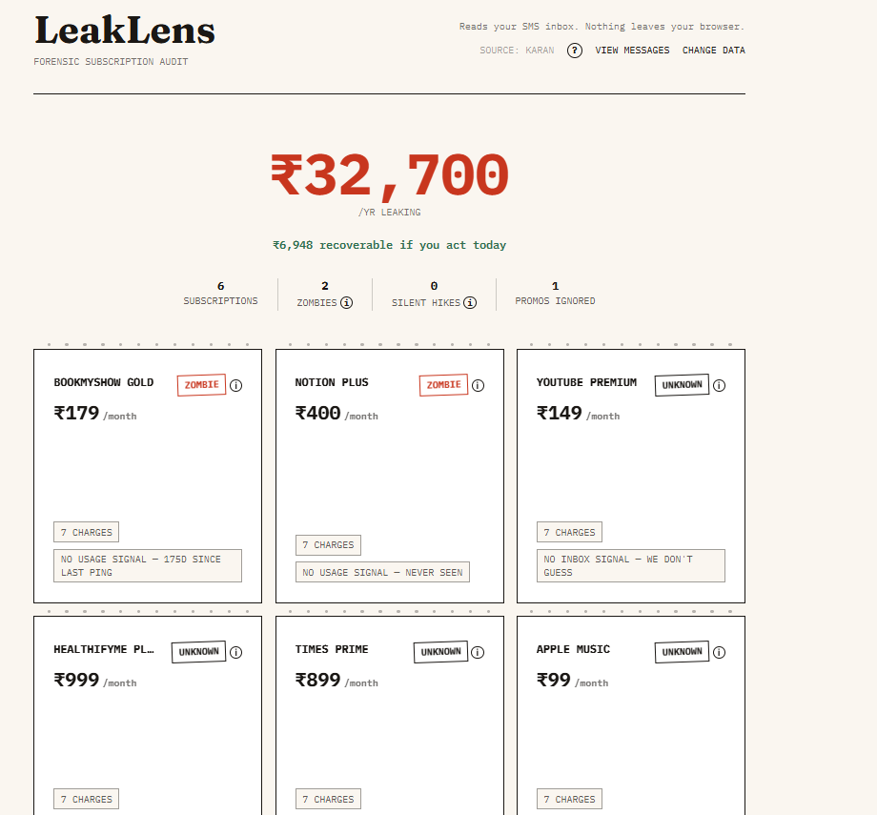
LEAKLENS
02 — THE SOLUTION & THE PRODUCT
One link. A complete
forensic audit.
Open LeakLens, point it at your own inbox export or the bundled demo data — nothing ever leaves the browser tab.
Leak total, front and center
The annual bleed and recoverable amount as the very first thing you see.
Per-card evidence
Charge count and usage signal shown on every subscription — not just a verdict.
Three honest verdicts
Zombie, Price Hike, or Unknown — never a guess dressed up as fact.
Zero-setup entry point.
03

Slide 4
LEAKLENS
03 — HOW LEAKLENS WORKS
Eight deterministic steps. Zero network calls.
01
02
03
04
05
06
07
08
Inbox
Parser
Merchant Resolver
Recurrence Detection
Usage Matching
Leak Score
Action Planner
Dashboard
›
›
›
›
›
›
›
Inbox export in → leak score out. Every stage runs locally in the browser; nothing is ever transmitted.
ZERO
100%
FULL
network requests
client-side execution
score breakdown shown
04

Slide 5
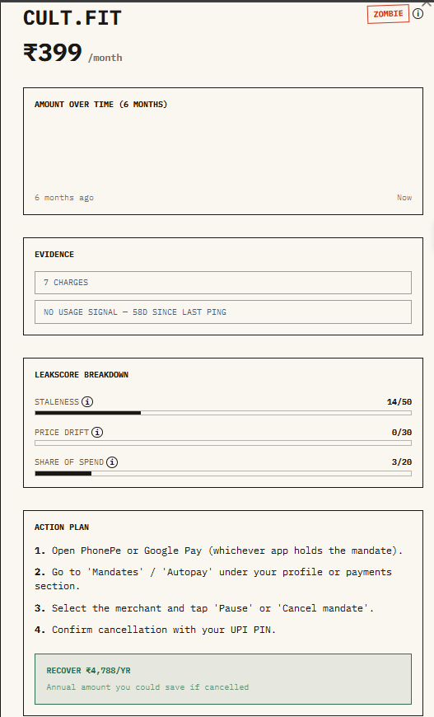
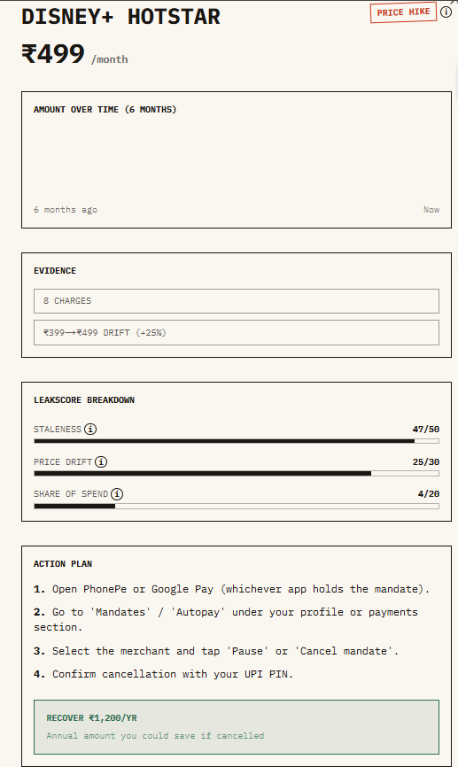
LEAKLENS
04 — REAL DETECTION EXAMPLES
Two ways LeakLens catches a leak.
Zombie Subscription
Silent Price Hike
cult.fit still bills ₹399/month. Seven charges, zero usage pings since — flagged Zombie with a full score breakdown.
Disney+ Hotstar quietly raised its mandate by 25% over six months — caught by diffing historical charges.
Staleness
Staleness
14 / 50
47 / 50
Price drift
Price drift
0 / 30
25 / 30 (+25%)
Share of spend
Share of spend
3 / 20
4 / 20
RECOVER ₹4,788/yr
RECOVER ₹1,200/yr
Annual savings if cancelled
Annual savings if cancelled
05

Slide 6
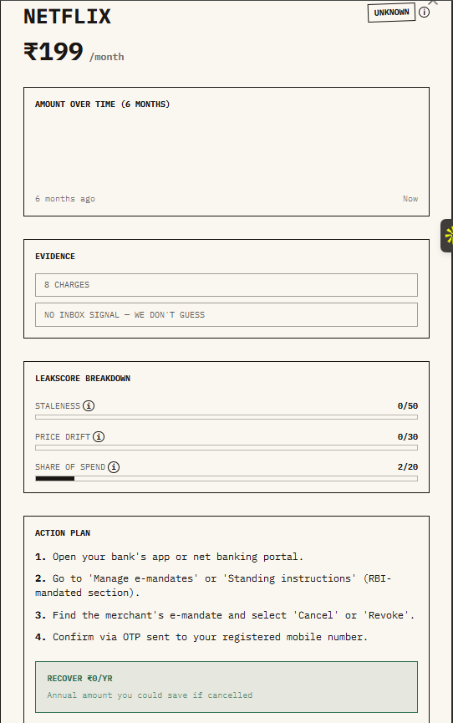
LEAKLENS
05 — WHY WE WIN & PROOF
Built different. Proven on real data.
Capability
Traditional
LeakLens
Usage detection
No
Yes
Price drift alerts
Rare
Yes
Privacy model
Bank OAuth
100% client-side
“Unknown” is a real verdict — not swept to Zombie.
Confidence labeling
No
Zombie / Hike / Unknown
DEMO RESULTS — TESTED ON A REAL INBOX
2
1
₹7,176
leaklens-henna.vercel.app
Tested across 3 real-shaped inboxes — no synthetic data.
ZOMBIE SUBSCRIPTIONS
SILENT PRICE HIKE
RECOVERABLE / YEAR
06

Slide 7
LEAKLENS
06 — WHAT'S NEXT
UPI AutoPay is multiplying subscriptions faster than anyone can track them.
NOW
NEXT
FUTURE
— SMS parsing
— Email parsing
— AI recommendations
— Zombie detection
— Chrome extension
— Family plan detection
— Price hike alerts
— Mobile app
— Enterprise monitoring
— Dashboard
LEAKLENS
Thank you.
leaklens-henna.vercel.app
Your inbox already knows which subscriptions you've stopped using.
07

